Slide 1

Grocery Store Managment
Presented by
Neeraj Kumar Sunkari
Samala Jayachandra Prasad
J Sai Prakash

Slide 2

INTRODUCTION
This project focuses on designing and implementing a relational database system for a grocery store. The system manages key operations such as products, suppliers, customers, employees, and orders.
By using SQL, we can:
Store and organize retail data efficiently.
Retrieve and analyze customer, product, and sales information.
Generate insights to improve business performance and decision-making.
Purpose:
To simulate a real-world grocery store scenario where database queries help track sales, revenue trends, product performance, and employee contributions.

Slide 3
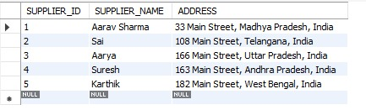
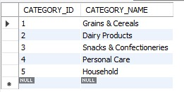
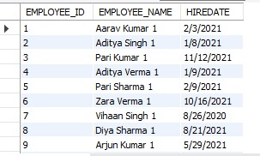
TABLES
Supplier Table
Category Table
Employees Table

Slide 4
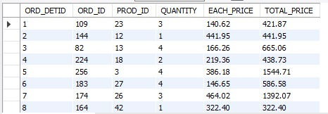
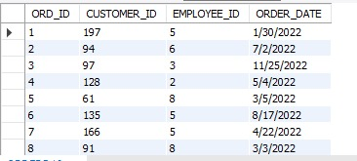
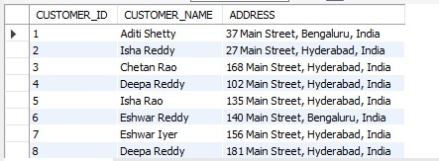
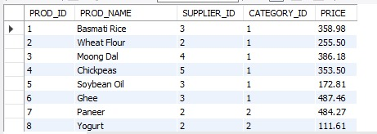
Order Details Table
Orders Table
Customers Table
Products Table

Slide 5

PROBLEM STATEMENT
Managing a grocery store involves handling large amounts of data related to suppliers, products, customers, employees, and orders.
Without a structured database system, businesses face challenges such as:
Difficulty in tracking sales and revenue.
Lack of visibility into product availability and performance.
Challenges in analyzing customer behavior and supplier contributions.
Limited insights into employee performance and store operations.
Inefficient decision-making due to unorganized and inconsistent data.

Slide 6
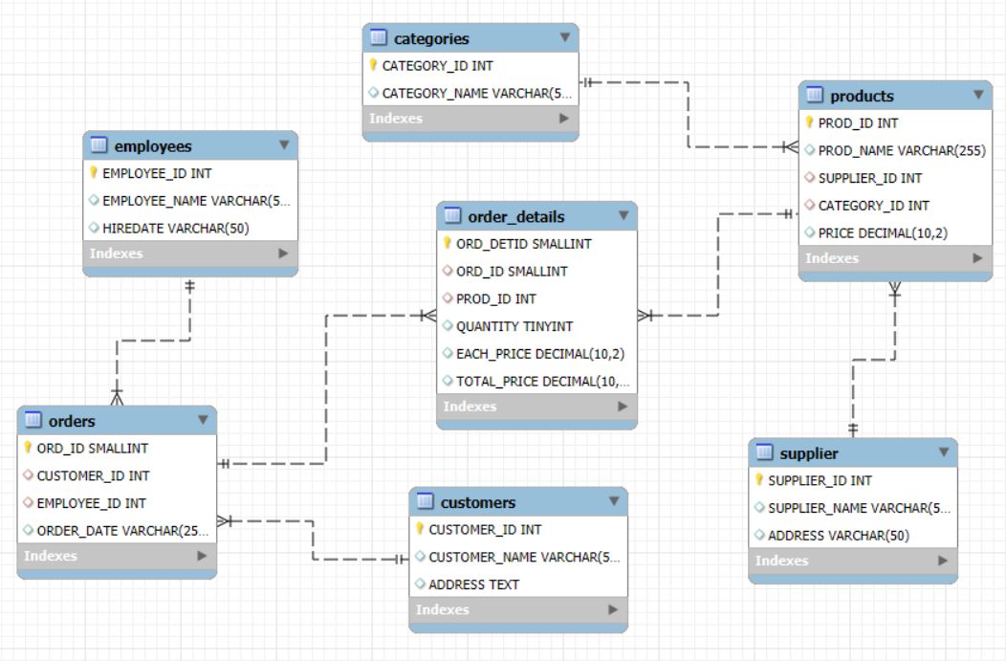
ER DIAGRAM

Slide 7

ANALYSIS QUESTIONS
1. How many unique customers have placed orders?
Query
Result

Slide 8
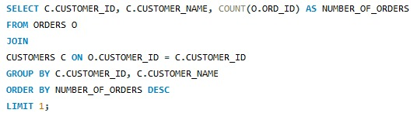

2. Which customers have placed the highest number of orders?
Query
Result

Slide 9
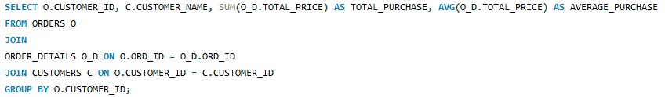
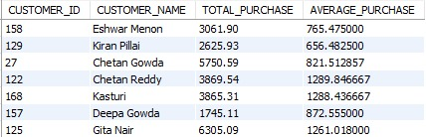
3. What is the total and average purchase value per customer?
Query
Result

Slide 10
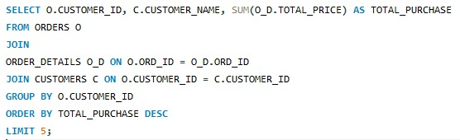
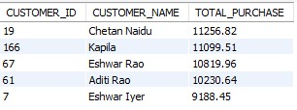
4. Who are the top 5 customers by total purchase amount?
Query
Result

Slide 11
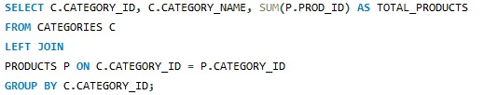
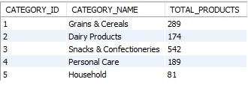
5. How many products exist in each category?
Query
Result

Slide 12
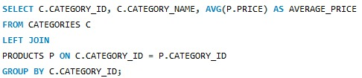
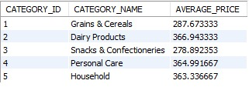
6. What is the average price of products by category?
Query
Result

Slide 13
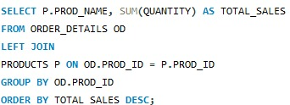
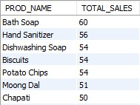
7. Which products have the highest total sales volume (by quantity)?
Query
Result

Slide 14
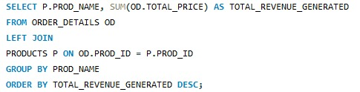
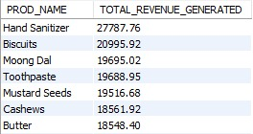
8. What is the total revenue generated by each product?
Query
Result

Slide 15
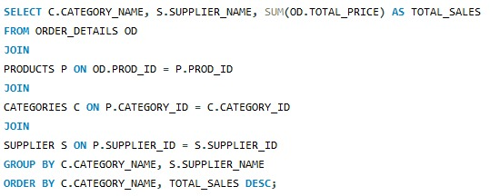
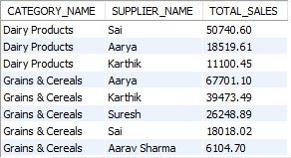
9. How do product sales vary by category and supplier?
Query
Result

Slide 16


10. How many orders have been placed in total?
Query
Result

Slide 17

11. What is the average value per order?
Query
Result

Slide 18
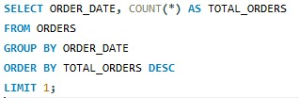

12. On which dates were the most orders placed?
Query
Result

Slide 19
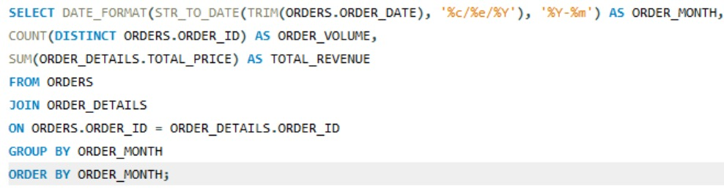
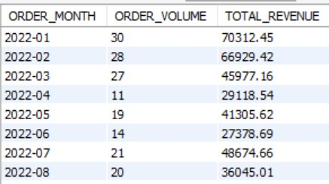
13. What are the monthly trends in order volume and revenue?
Query
Result

Slide 20
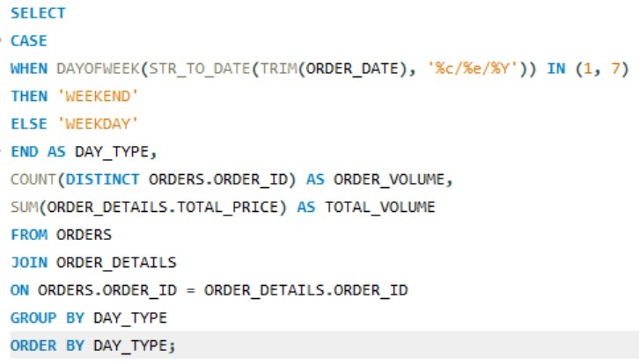

14. How do order patterns vary across weekdays and weekends?
Query
Result

Slide 21
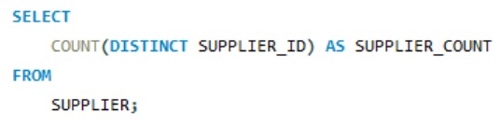

15. How many suppliers are there in the database?
Query
Result

Slide 22
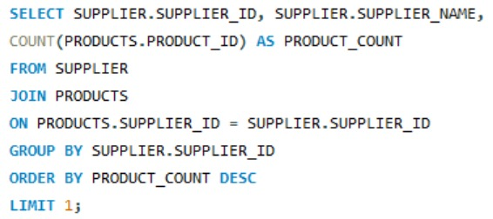

16. Which supplier provides the most products?
Query
Result

Slide 23
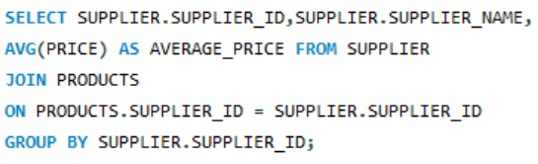
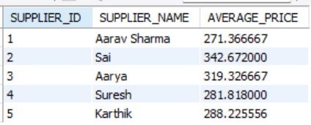
17. What is the average price of products from each supplier?
Query
Result

Slide 24
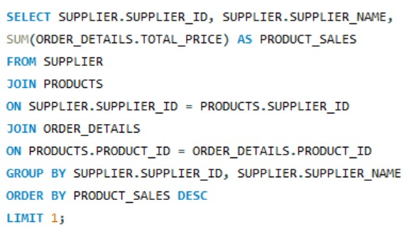

18. Which suppliers contribute the most to total product sales (by revenue)?
Query
Result

Slide 25
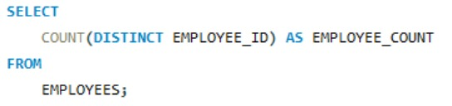

19. How many employees have processed orders?
Query
Result

Slide 26
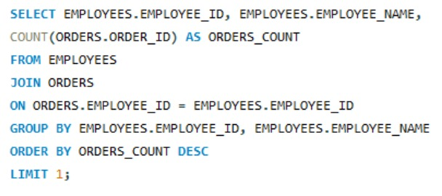

20. Which employees have handled the most orders?
Query
Result

Slide 27
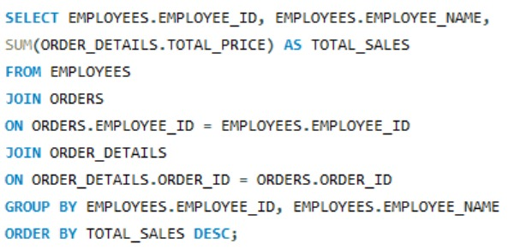
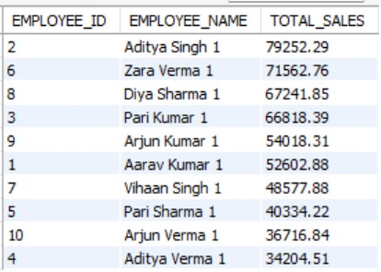
21. What is the total sales value processed by each employee?
Query
Result

Slide 28
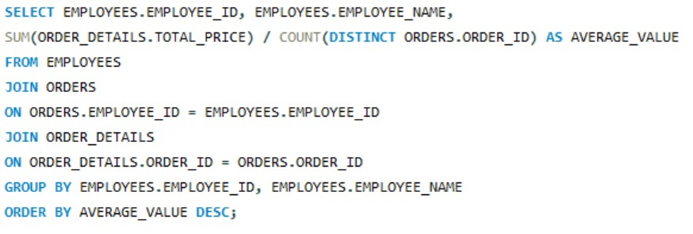
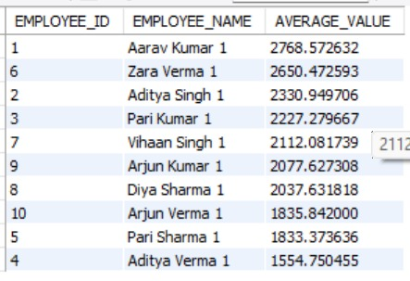
22. What is the average order value handled per employee?
Query
Result

Slide 29
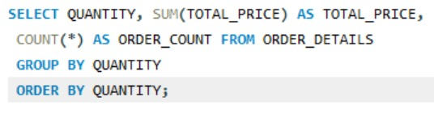
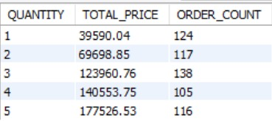
23. What is the relationship between quantity ordered and total price?
Query
Result

Slide 30
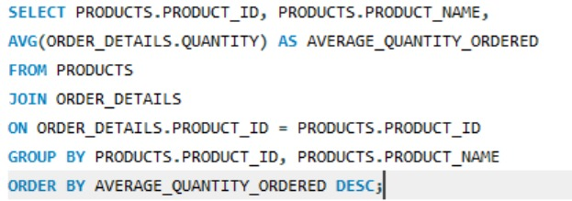
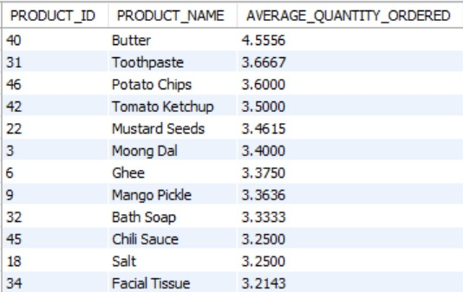
24. What is the average quantity ordered per product?
Query
Result

Slide 31
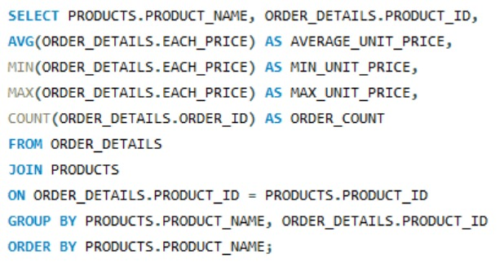
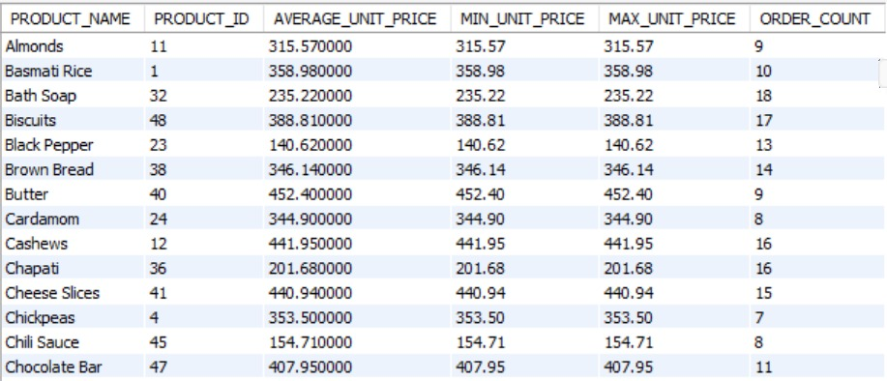
25. How does the unit price vary across products and orders?
Query
Result

Slide 32

THANK YOU

